Slide 1
Location Strategies
8
Transportation Models
C
MODULE

Slide 2
Location

Slide 3
Strategic Importance of Location
The objective of location strategy is to maximize the benefit of location to the firm
Options include
Expanding existing facilities
Maintain existing and add sites
Closing existing and relocating
Once committed to a location, many resource and cost issues are difficult to change

Slide 4
Factors
Proximity to markets
Very important to services
JIT systems or high transportation costs may make it important to manufacturers
Proximity to suppliers
Perishable goods
High transportation costs
Bulky/heavy products
Proximity to competitors (clustering)
Often driven by resources such as natural, information, capital, talent
Found in both manufacturing and service industries

Slide 5
Location Decisions
Country Decision
Key Success Factors
Political risks, government rules, attitudes, incentives
Cultural and economic issues
Location of markets
Labor talent, attitudes, productivity, costs
Availability of supplies, communications, energy
Exchange rates and currency risks
Figure 8.1

Slide 6
Location Decisions
Region/ Community Decision
Key Success Factors
Corporate desires
Attractiveness of region
Labor availability and costs
Costs and availability of utilities
Environmental regulations
Government incentives and fiscal policies
Proximity to raw materials and customers
Land/construction costs
MN
WI
MI
IL
IN
OH
Figure 8.1

Slide 7
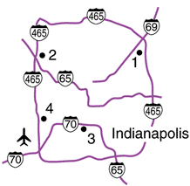
Location Decisions
Site Decision
Key Success Factors
Site size and cost
Air, rail, highway, and waterway systems
Zoning restrictions
Proximity of services/ supplies needed
Environmental impact issues
Customer density and demographics
Figure 8.1

Slide 8
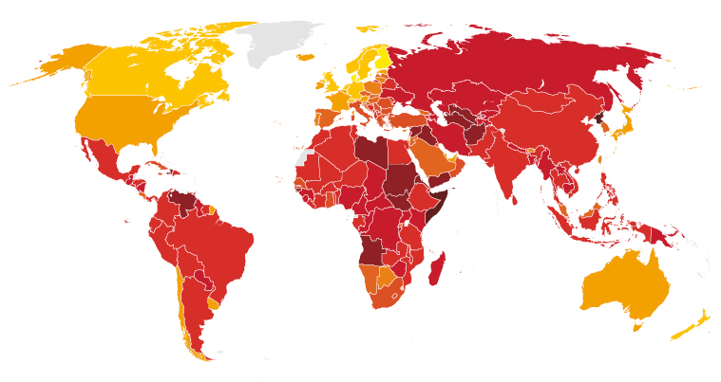

Ranking Corruption
Rank Country 2015 CPI Score (out of 100)
1 Demark 91
2 Finland 90
3 Sweden 89
4 New Zealand 88
5 Netherlands, Norway, 87
7 Switzerland 86
8 Singapore 85
9 Canada 83
10 Germany, UK 81
16 USA 76
18 Japan 75
17 USA 74
30 Taiwan 62
37 South Korea 56
83 China 37
119 Russia 29
Least Corrupt
Most Corrupt

Slide 9
Transportation

Slide 10
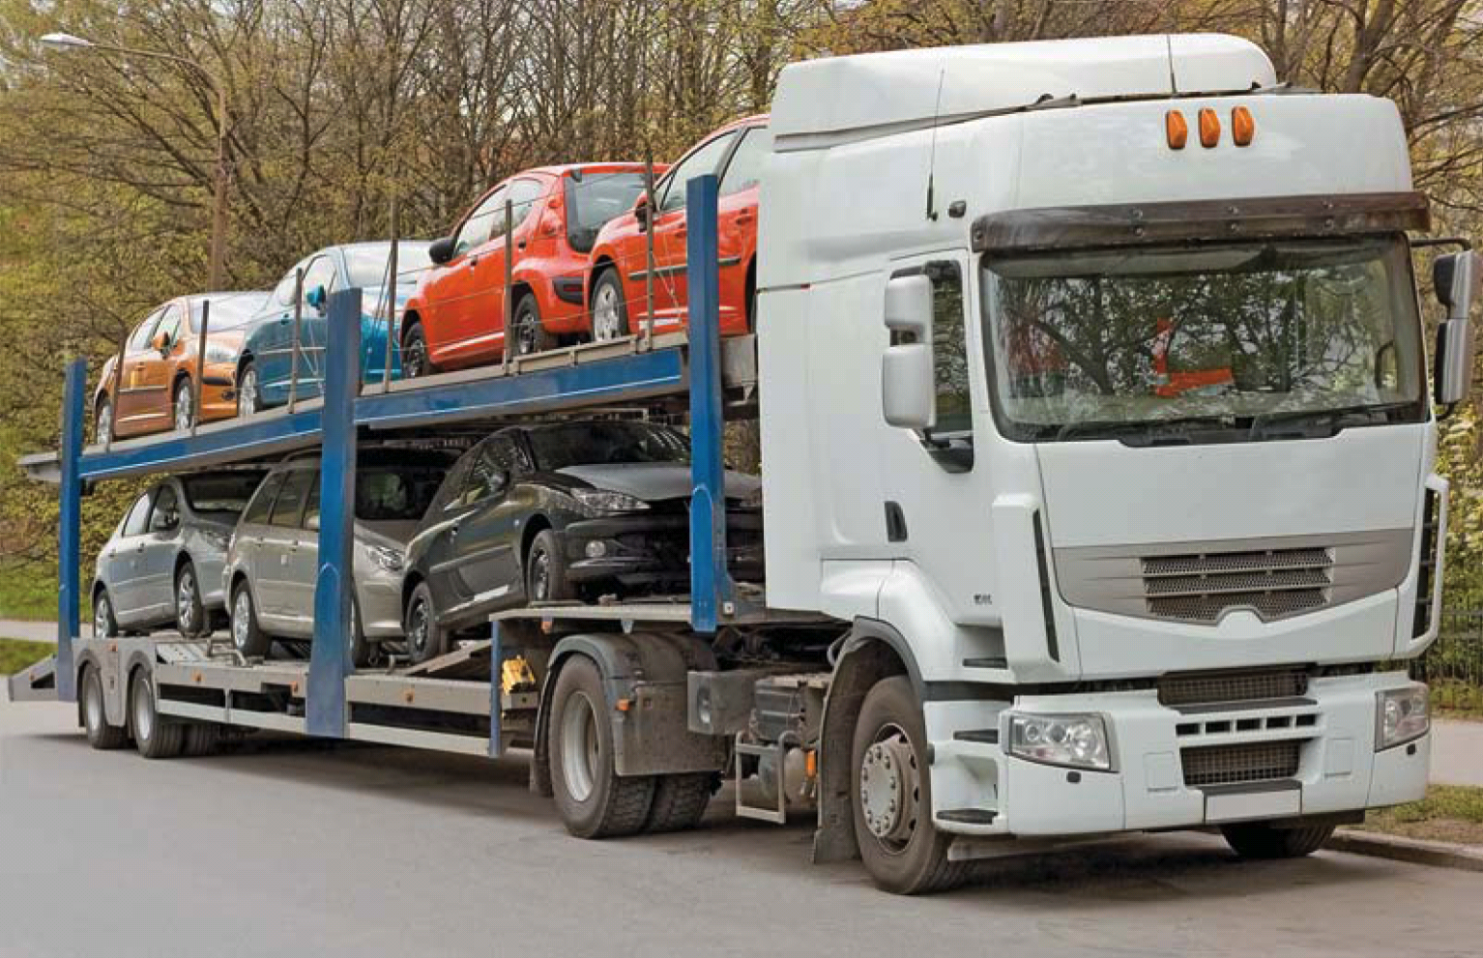
Transportation Modeling
An iterative procedure that finds the least costly means of moving products from a series of sources to a series of destinations
Can be used to help resolve distribution and location decisions

Slide 11
Transportation Modeling
A special class of linear programming
Need to know
The origin points or sources
Capacity or supply per period at each origin
The destinations
Demand per period at each destination
The cost of shipping one unit from each origin to each destination

Slide 12
Transportation Problem
TABLE C.1 | Transportation Costs per Bathtub for Arizona Plumbing
TO FROM
 |  | ALBUQUERQUE | BOSTON | CLEVELAND
Des Moines |  | $5 | $4 | $3
Evansville |  | $8 | $4 | $3
Fort Lauderdale |  | $9 | $7 | $5

Slide 13


Transportation Problem
Boston
(200 units
required)
Cleveland
(200 units
required)
Des Moines
(100 units
capacity)
Albuquerque
(300 units
required)
Evansville
(300 units
capacity)
Figure C.1
Fort Lauderdale
(300 units
capacity)

Slide 14
Transportation Matrix
To
Factory capacity
Des Moines
capacity
constraint
From
Albuquerque
Boston
Cleveland
$5
$4
$3
Des Moines
100
Cell
representing a possible source-to-destination shipping assignment (Evansville to Cleveland)
$8
$4
$3
Evansville
300
$9
$7
$5
Fort Lauderdale
300
Warehouse requirement
300
200
200
700
Cost of shipping 1 unit from Fort
Lauderdale factory to Boston warehouse
Cleveland warehouse demand
Total demand
and total supply

Slide 15
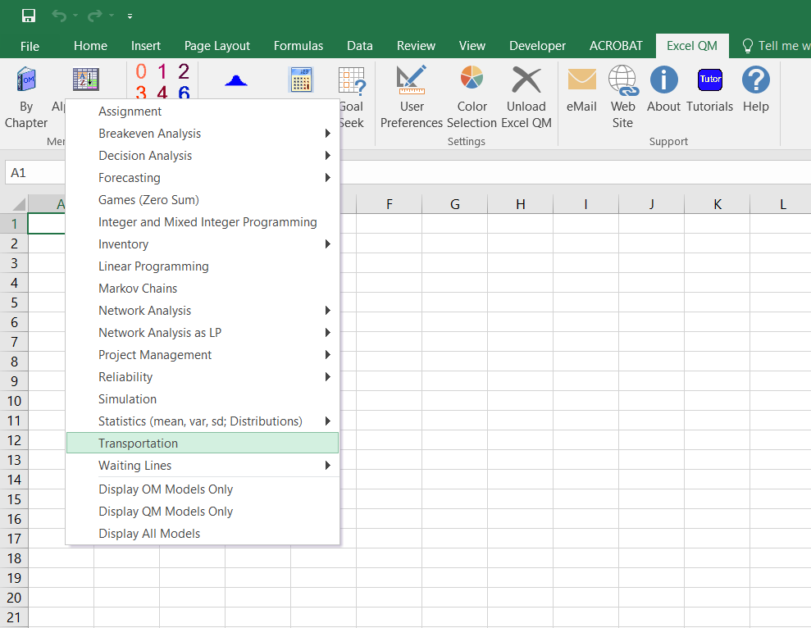
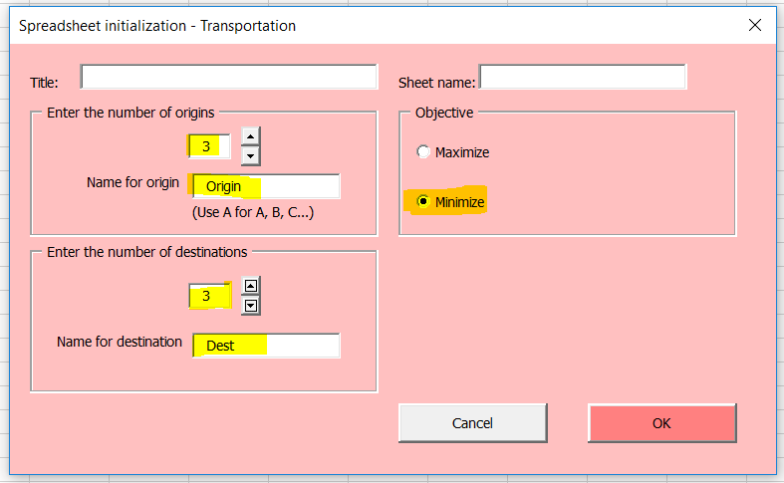
ExcelOM

Slide 16
Enter into ExcelOM
To
Factory capacity
From
Albuquerque
Boston
Cleveland
$5
$4
$3
Des Moines
100
$8
$4
$3
Evansville
300
$9
$7
$5
Fort Lauderdale
300
Warehouse requirement
300
200
200
700

Slide 17
Northwest-Corner Rule
Start in the upper left-hand cell (or northwest corner) of the table and allocate units to shipping routes as follows:
Exhaust the supply (factory capacity) of each row before moving down to the next row
Exhaust the (warehouse) requirements of each column before moving to the next column
Check to ensure that all supplies and demands are met
Good to know… but use ExcelOM

Slide 18
Intuitive Lowest-Cost Method
NOTE: ExcelOM = Minimum Cost Button
Identify the cell with the lowest cost
Allocate as many units as possible to that cell without exceeding supply or demand; then cross out the row or column (or both) that is exhausted by this assignment
Find the cell with the lowest cost from the remaining cells
Repeat steps 2 and 3 until all units have been allocated
Good to know… but use ExcelOM

Slide 19
Stepping-Stone Method
Select any unused square to evaluate
Beginning at this square, trace a closed path back to the original square via squares that are currently being used
Beginning with a plus (+) sign at the unused square, place alternate minus and plus signs at each corner of the path just traced
Calculate an improvement index by first adding the unit-cost figures found in each square containing a plus sign and subtracting the unit costs in each square containing a minus sign
Repeat steps 1 though 4 until you have calculated an improvement index for all unused squares. If all indices are ≥ 0, you have reached an optimal solution
Good to know… but use ExcelOM

Slide 20
What is the lowest cost?
To
Factory capacity
From
Albuquerque
Boston
Cleveland
$5
$4
$3
Des Moines
100
$8
$4
$3
Evansville
300
$9
$7
$5
Fort Lauderdale
300
Warehouse requirement
300
200
200
700

Slide 21
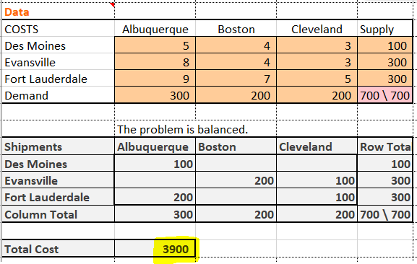
What is the lowest cost?

Slide 22
Unbalanced Demand/Supply
Demand not equal to supply
Called an unbalanced problem
Common situation in the real world
Resolved by introducing dummy sources or dummy destinations as necessary with cost coefficients of zero

Slide 23
Unbalanced Demand/Supply
To
Factory capacity
From
Albuquerque
Boston
Cleveland
$5
$4
$3
Des Moines
250
$8
$4
$3
Evansville
300
$9
$7
$5
Fort Lauderdale
300
Warehouse requirement
300
200
200
700
New Des Moines capacity (was 100)

Slide 24
Unbalanced Demand/Supply
How is the following table balanced in ExcelOM?
To
Factory capacity
From
Albuquerque
Boston
Cleveland
$5
$4
$3
Des Moines
250
$8
$4
$3
Evansville
300
$9
$7
$5
Fort Lauderdale
300
Warehouse requirement
300
200
200
700

Slide 25
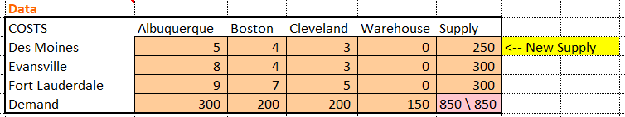
Unbalanced Demand/Supply
To
(A)
Albuquerque
(B)
Boston
(C)
Cleveland
Dummy
Factory capacity
From
(D) Des Moines
250
$5
$4
$3
0
250
50
$8
200
$4
50
$3
0
300
(E) Evansville
(F) Fort Lauderdale
$9
$7
150
$5
150
0
300
Warehouse requirement
300
200
200
150
850

Slide 26

Practice Quiz Problem
A firm has established a distribution network for the supply of a raw material critical to its manufacturing. Currently there are two origins for this raw material, which must be shipped to three manufacturing plants. The current network has the following characteristics:
The firm has identified two potential sites for a third raw material source; these are identified as Candidate A and Candidate B. From A, the costs to ship would be $9 to Plant 1, $10 to Plant 2, and $12 to Plant 3. From B, these costs would be $11, $14, and $8. The new source, wherever it is located, will have a capacity of 500 units. Solve with the transportation method. Which site should be selected?

Slide 27
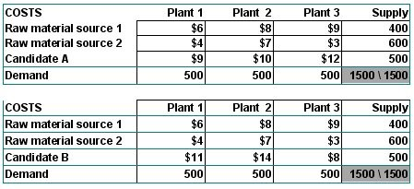
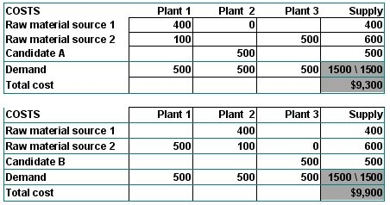
Practice Quiz Problem
Answer: This problem requires two transportation problems, each with three sources.
The solutions to these problems appear in the tables below.
Candidate A should be selected.

Slide 28
Answer the Following
What are the five information needs of the transportation model as discussed in this presentation?
How do you know when an optimal solution has been reached?
All of the transportation examples appear to apply to long distances. Is it possible for the transportation model to apply on a much smaller scale, for example, within the departments of a store or the offices of a building? Discuss.
What is meant by an unbalanced transportation problem, and how would you balance it?

Slide 29
Extra Info

Slide 30
Strategic Importance
One of the most important decisions a firm makes
Increasingly global in nature
Significant impact on fixed and variable costs
Decisions made relatively infrequently
Long-term decisions

Slide 31
Location Strategies
TABLE 8.6 | Location Strategies – Service vs. Goods-Producing Organizations
SERVICE/RETAIL/PROFESSIONAL |  | GOODS-PRODUCING
REVENUE FOCUS |  | COST FOCUS
Volume/revenue Drawing area; purchasing power Competition; advertising/pricing Physical quality Parking/access; security/lighting; appearance/ image Cost determinants Rent Management caliber Operation policies (hours, wage rates) |  | Tangible costs Transportation cost of raw material Shipment cost of finished goods Energy and utility cost; labor; raw material; taxes, and so on Intangible and future costs Attitude toward union Quality of life Education expenditures by state Quality of state and local government

Slide 32
Location Strategies
TABLE 8.6 | Location Strategies – Service vs. Goods-Producing Organizations
SERVICE/RETAIL/PROFESSIONAL |  | GOODS-PRODUCING
TECHNIQUES |  | TECHNIQUES
Regression models to determine importance of various factors Factor-rating method Traffic counts Demographic analysis of drawing area Purchasing power analysis of area Center-of-gravity method Geographic information systems |  | Transportation method Factor-rating method Locational cost–volume analysis Crossover charts
ASSUMPTIONS |  | ASSUMPTIONS
Location is a major determinant of revenue High customer-contact issues are critical Costs are relatively constant for a given area; therefore, the revenue function is critical |  | Location is a major determinant of cost Most major costs can be identified explicitly for each site Low customer contact allows focus on the identifiable costs Intangible costs can be evaluated

